Slide 1

IIIT Bhubaneswar
1
Department Of Computer Secience & Engineering

Slide 2
MAJOR PROJECT PRESENTATION
Project Name: Real Time Human Pose Estimation
Project Members Name
Shrey Sahay B421047
Piyush Kumar Nayak B521044
Hemant Sah
B421025

Slide 3
INDEX
S.No | Topics | Page No
1. | Constraints | 4
2. | Introduction | 5 - 6
3. | Types Of Pose Estimation | 7 - 9
4. | Approach and Architecture | 10 - 15
5. | Libraries | 16 - 19
6. | Flow of Project | 20 - 21
7. | Website Home Page | 22
8. | Use Cases | 23
9. | The Future Scope | 24
10. | Conclusion | 25

Slide 4
CONSTRAINTS
Pose estimation is a vast topic and considering their types (2D pose estimation and 3D pose estimation) we had restricted our project to the 2D pose estimation which is the estimation of keypoints of object or image along x and y coordinate.
On the other hand the implementation can be done in several ways. But we will estimate the single and multi pose with the help of Browser.
Here we are not going to train the Machine Learning models, instead we had used java script libraries which have inbuilt capabilities of Machine Learning and just by using some import commands we will have access to those Machine Learning models.

Slide 5
INTRODUCTION
‹#›
The Human Pose Estimation is the task of using a machine learning model to estimate the approximate pose of a person from an image or a video by estimating the spatial locations of key body joints that is called keypoints.
The Aim of this project is to deliver the basic use cases of the Pose Net model for real-time human pose estimation using a webcam feed as the data.
TensorFlow.js is a JavaScript library that enables the training and deployment of machine learning models in the browser.

Slide 6
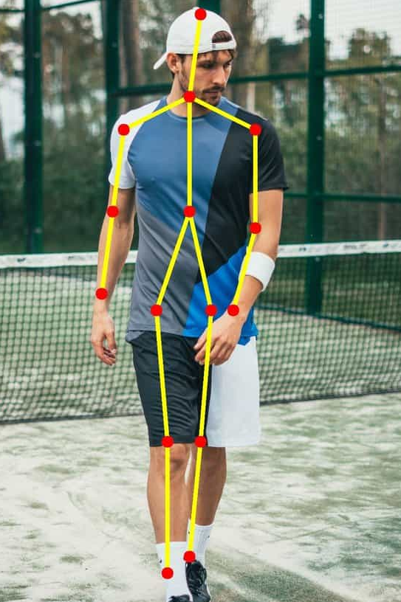
POSE ESTIMATION
Definition: Real-time human pose estimation is a technique that involves detecting and tracking human body parts in real-time video or image data.
Explanation: Real-time human pose estimation uses computer vision and machine learning techniques to identify the location and orientation of each body part.
Use cases: Human action recognition, human-computer interaction, video surveillance, fitness, health tracking, and gesture recognition.

Slide 7
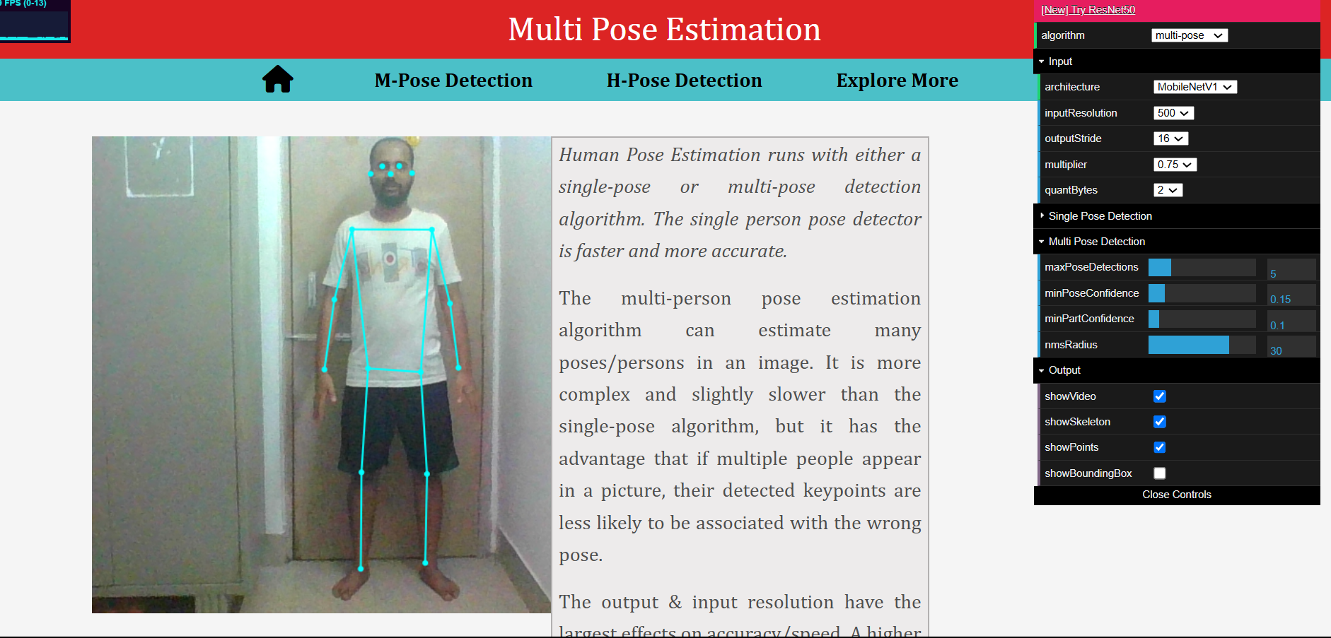
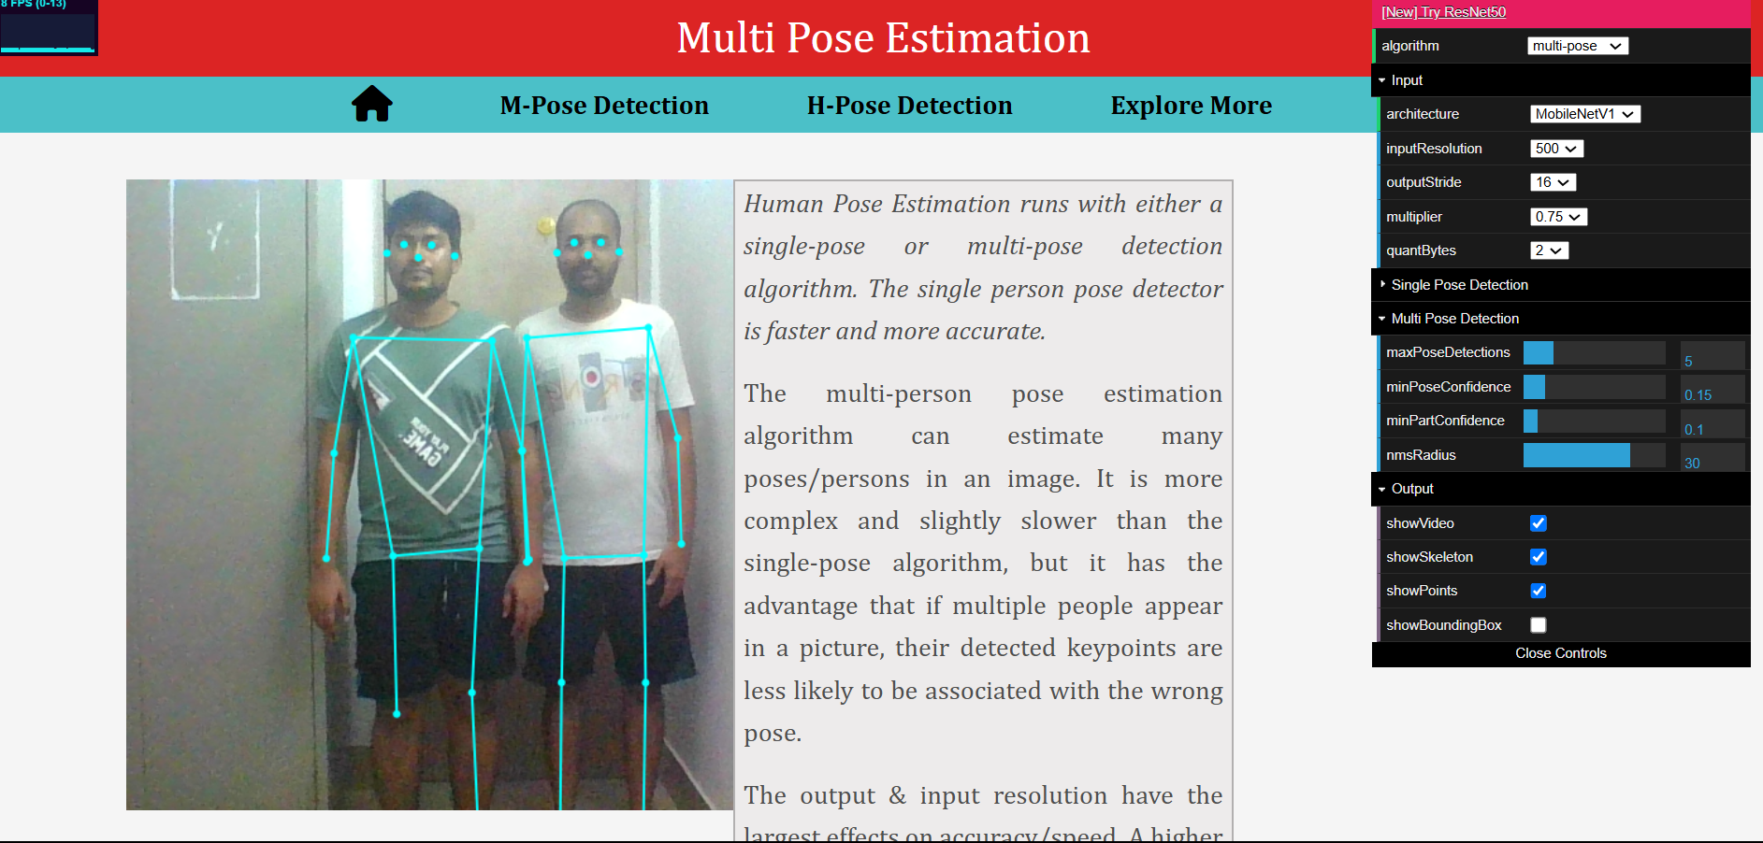
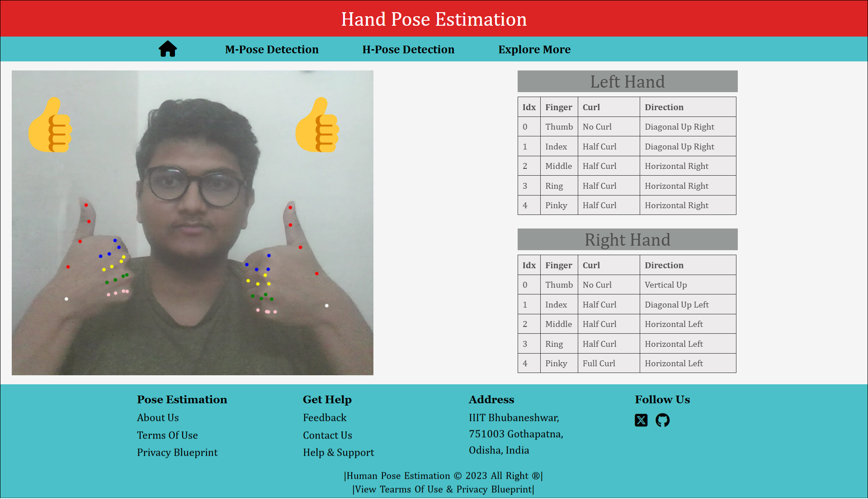
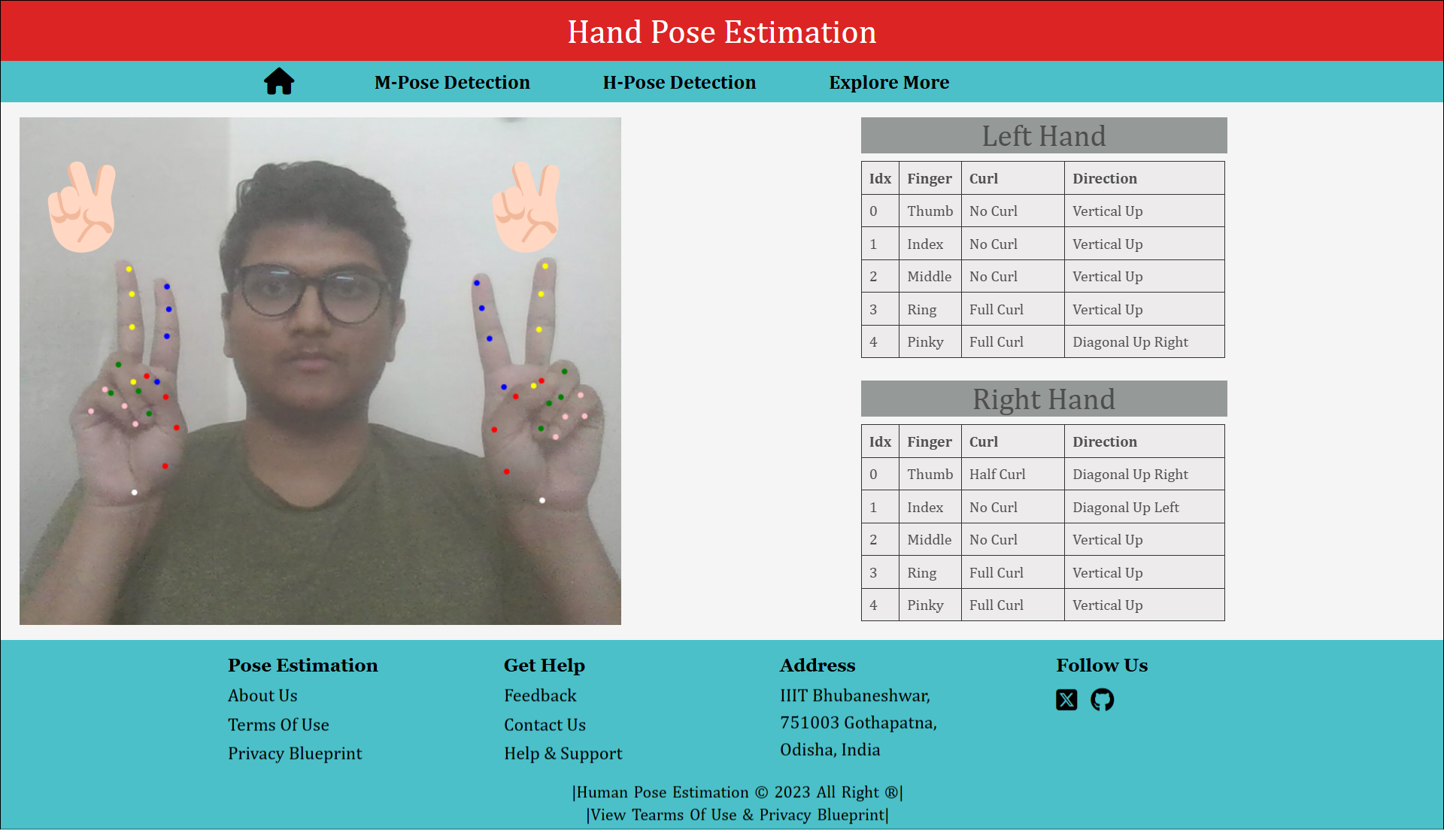
TYPES OF POSE ESTIMATION
‹#›

Slide 8
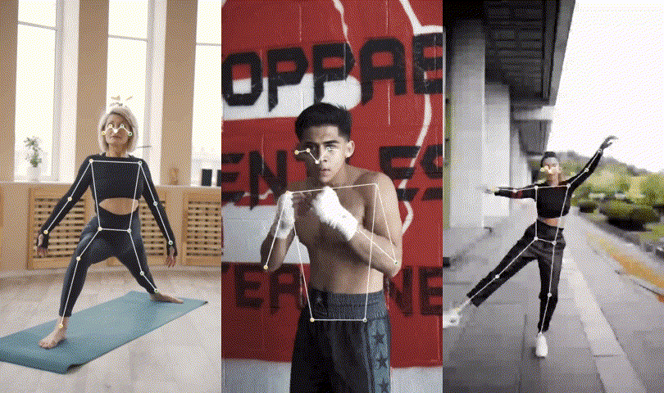
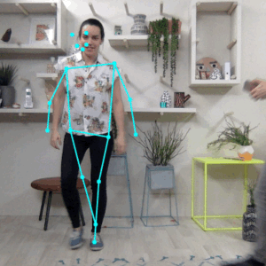
SINGLE POSE ESTIMATION
MULTI POSE ESTIMATION
Pose Estimation can estimate either a single pose or multiple poses, meaning there is a version of the algorithm that can detect only one person in an image/video and one version that can detect multiple persons in an image/video.

Slide 9
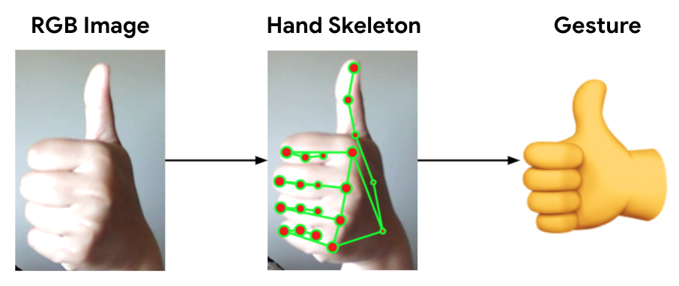
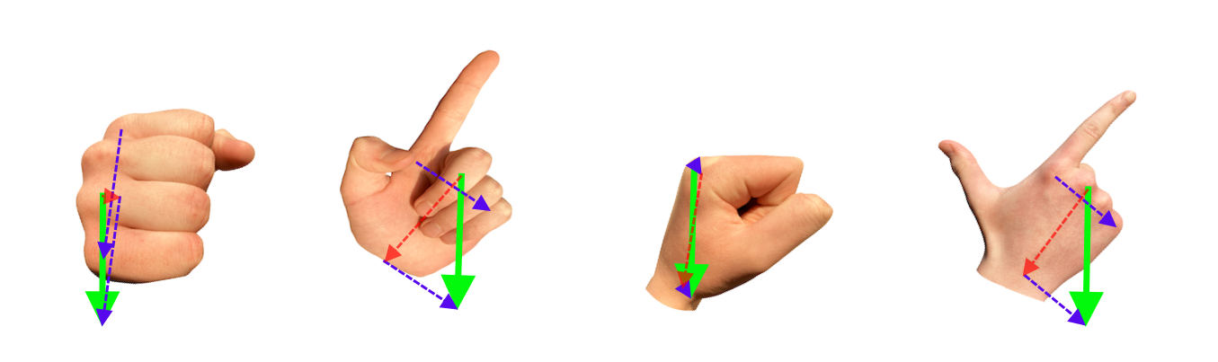
HAND POSE ESTIMATION

Slide 10

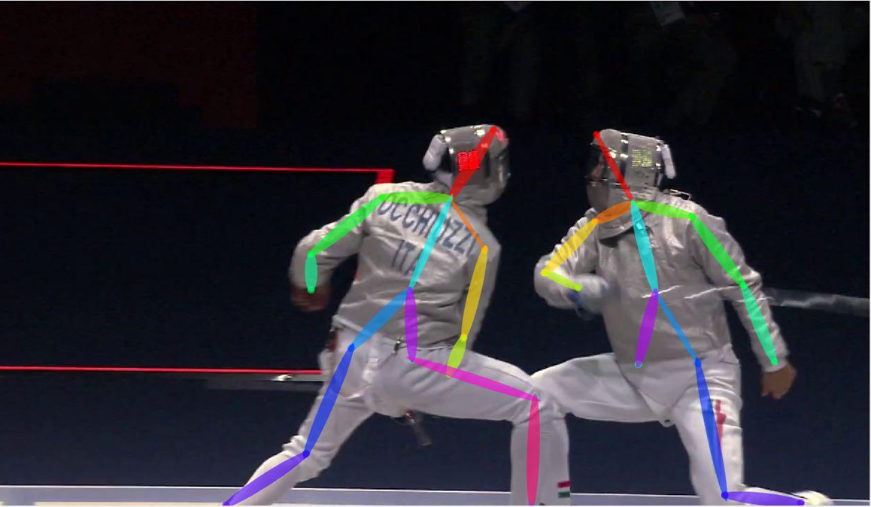
Bottom Up approach

Slide 11
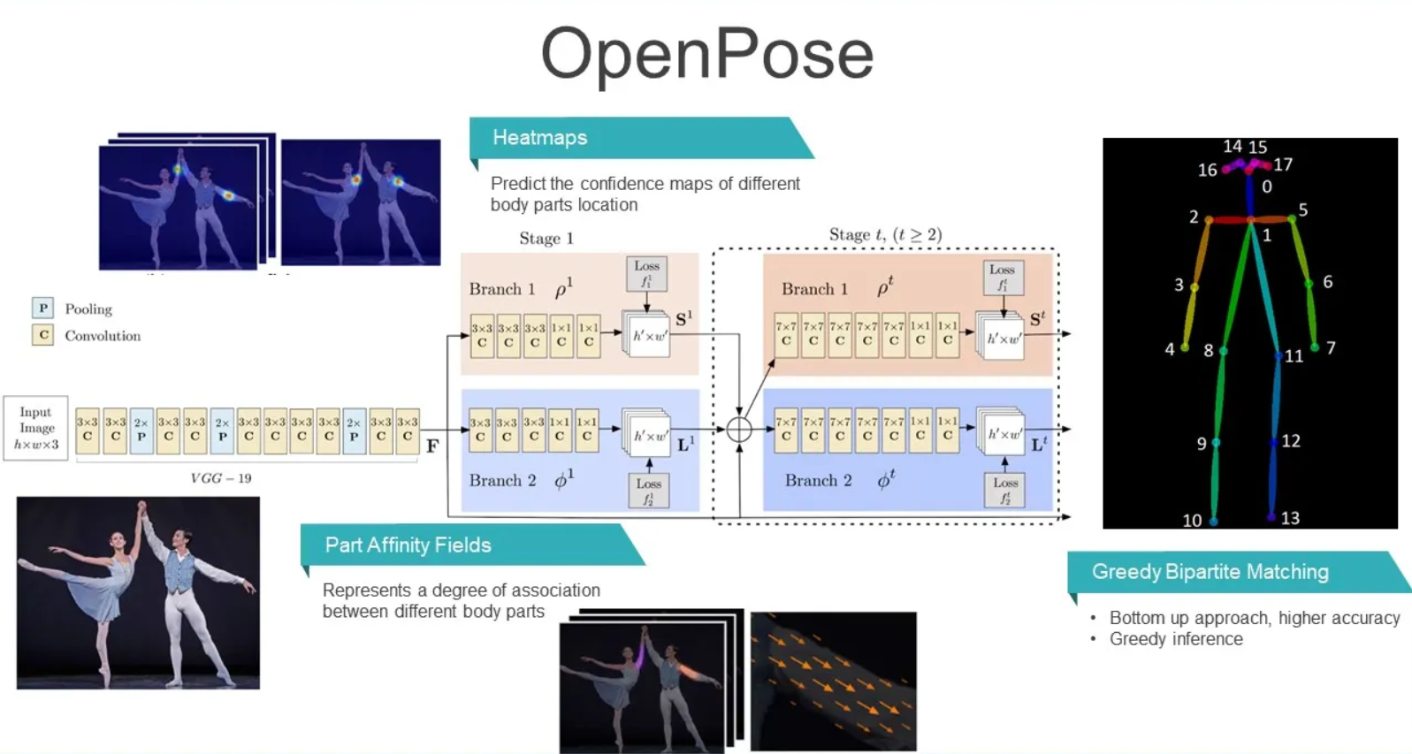
OpenPose Architecture

Slide 12
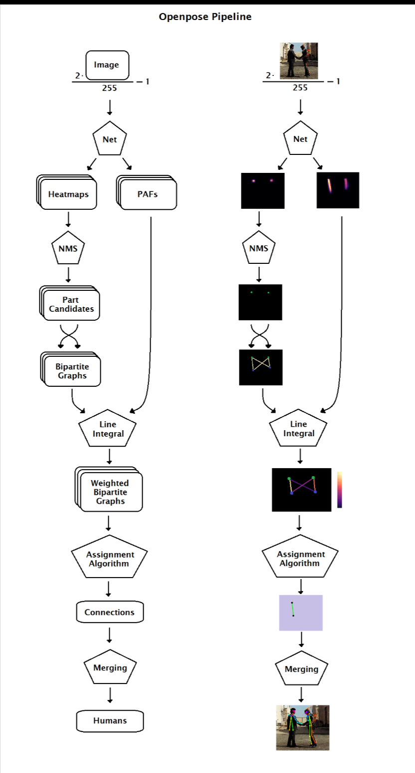
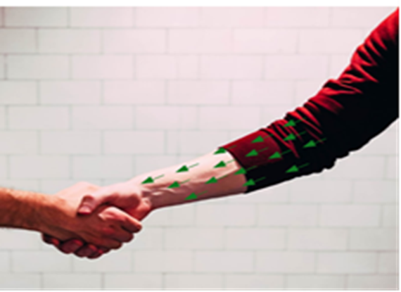
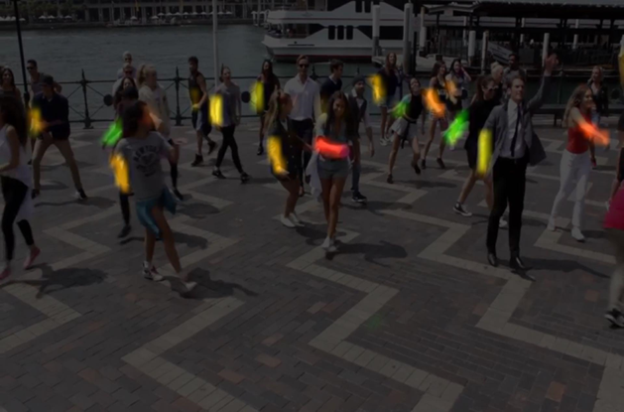
Path affinity fields

Slide 13
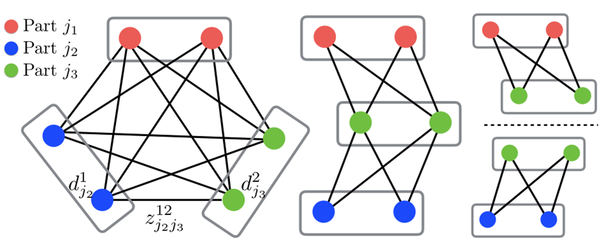
Bottom Up Parsing

Slide 14
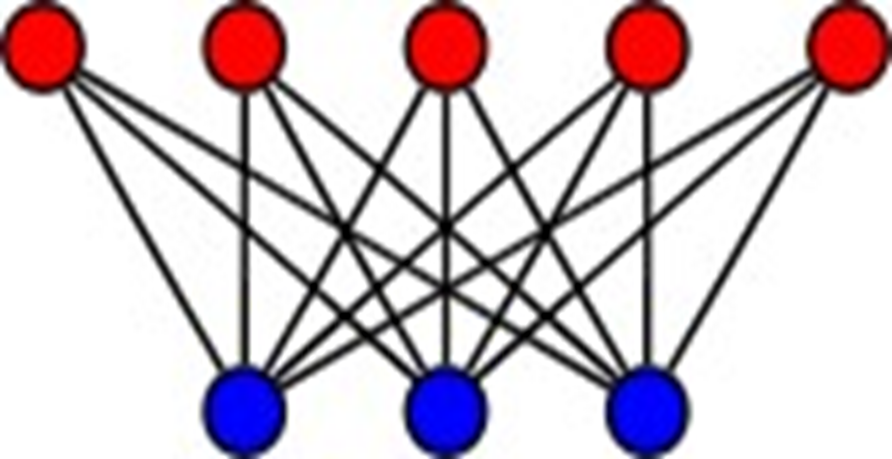
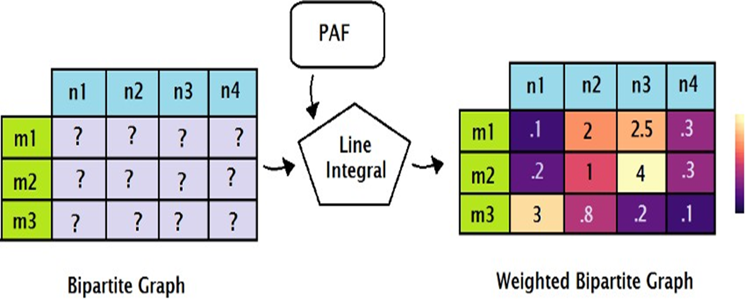
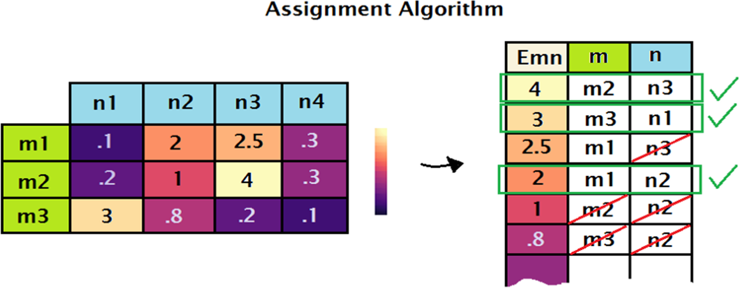
Bipartite Graph

Slide 15
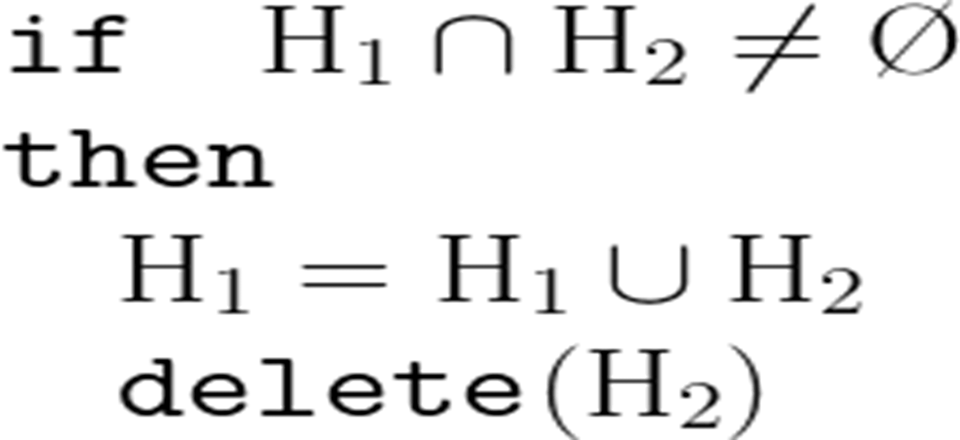
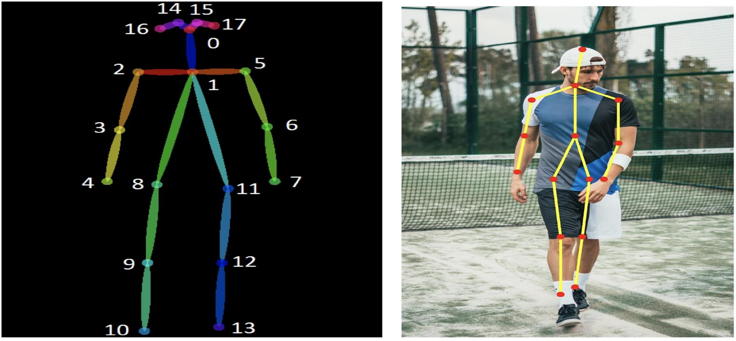
Merging Algo Pose Estimation Output

Slide 16
Libraries/Frameworks and Models
Following are the technologies that we had used to implement the real time human pose estimation project in web browser .
TensorFlow
Mediapipe
Posenet

Slide 17
1. Tensor Flow
Definition: TensorFlow.js is a JavaScript library that enables the training and deployment of machine learning models on the browser and Node.js.
Overview of features: It allows developers to use high-level APIs and pre-trained models, run models in the browser, and create interactive applications with machine learning capabilities.
Links: https://www.tensorflow.org/
Datasets Used : COCO , MPII for pose estimation
300W-LP for face detection
Hand Tracking 21-Keypoint

Slide 18
2. MediaPipe
Definition: MediaPipe is an open-source machine learning framework developed by Google for building real-time applications that process video, images, and audio.
Overview of features: It supports cross-platform deployment (Web, Android, iOS, Desktop) with low-latency inference optimized for CPU & GPU acceleration. Its modular pipeline enables efficient multi-task learning, making it ideal for AI-powered applications in AR, gaming, and healthcare .
Link

Slide 19
3. Posenet
Definition: PoseNet is a deep learning-based real-time human pose estimation model developed by Google. It detects keypoints of the human body (nose, eyes, shoulders, elbows, etc.) from images or
Videos .
Overview of features: Optimized for mobile and web applications, it runs seamlessly in browsers using TensorFlow.js and supports CPU, GPU, and WebGL acceleration.
Link

Slide 20
FLOW OF THE PROJECT
1. Data Collection And Data Preprocessing
2. Model Selection
3. Integration with Web Browser
4. User Input
5. Inference
6. Visualization

Slide 21
FLOW OF THE PROJECT
7. Optimization
8. Testing
9. Deployment

Slide 22
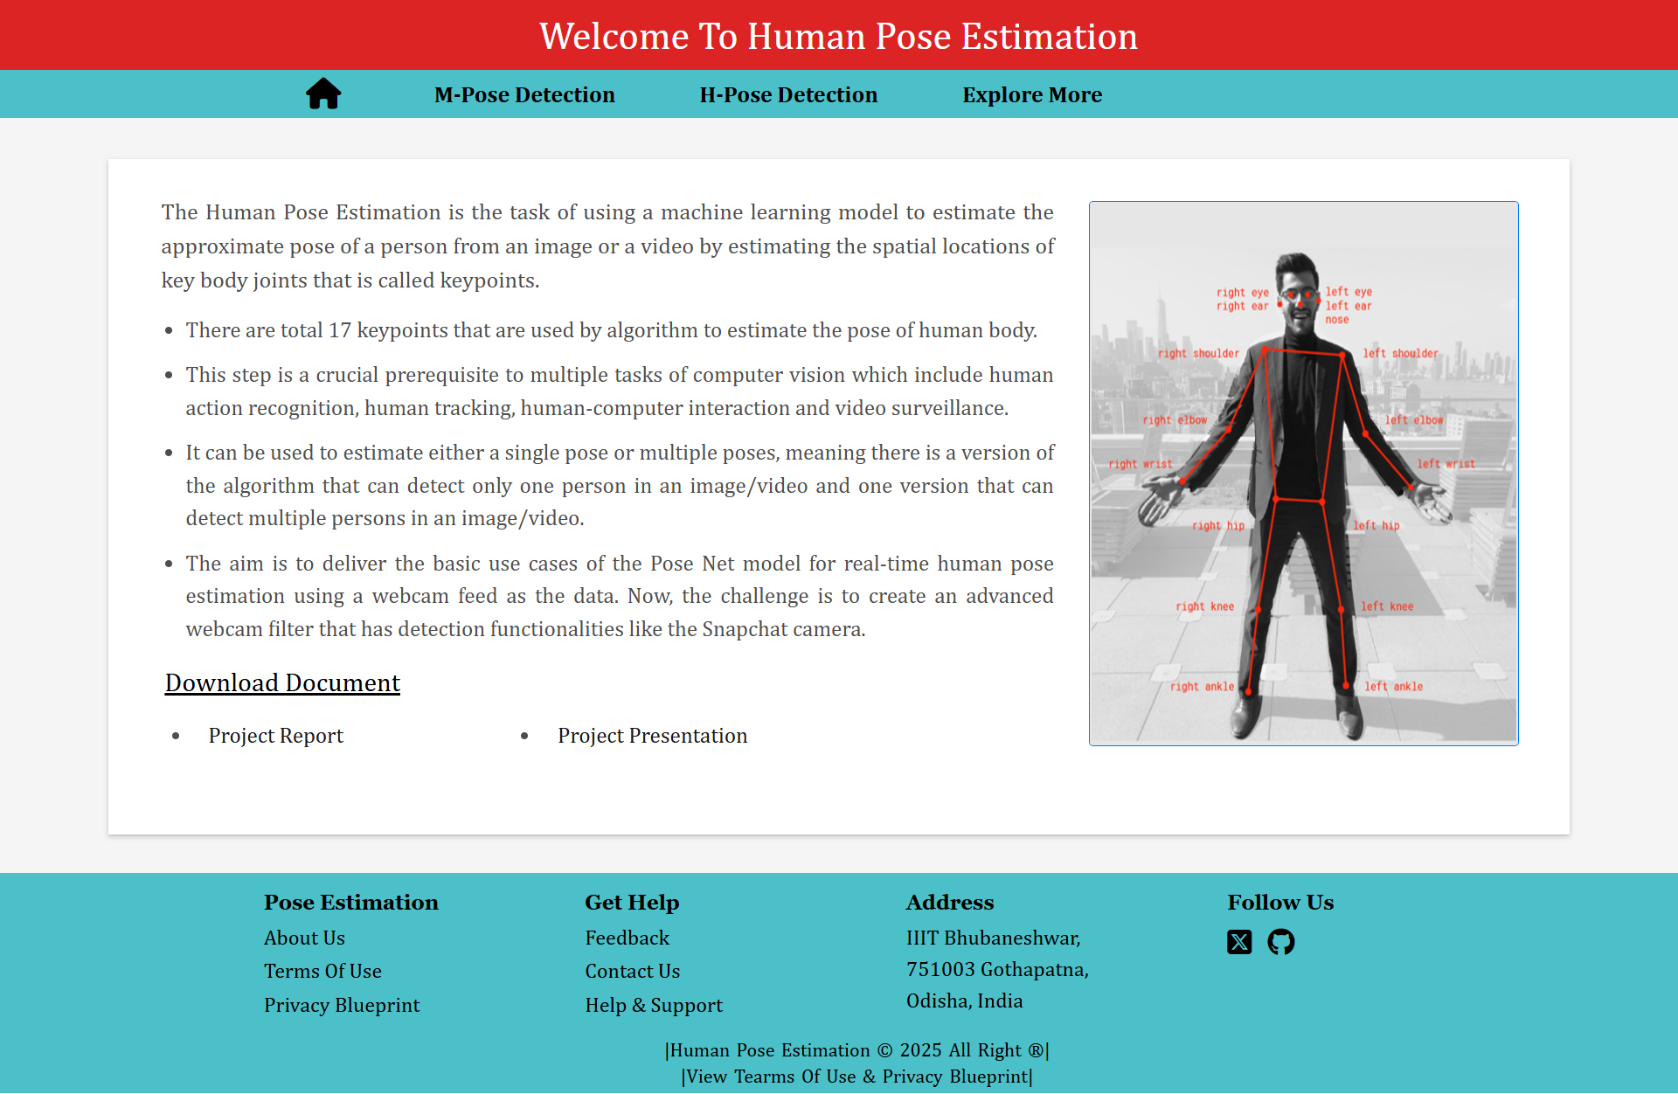
WEBSITE HOME PAGE

Slide 23
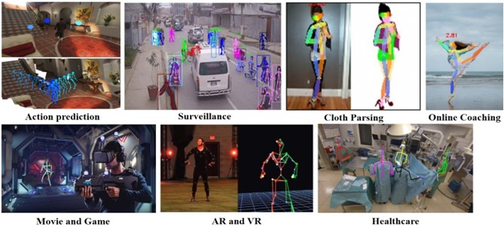
USE CASES

Slide 24
THE FUTURE SCOPE
‹#›
1. Real-Time Pose Estimation on Edge Devices
2. Privacy and Security Considerations
3. Real-Time Feedback and Coaching
4. Collaborative Pose Estimation
5. Self-Supervised Learning
6. Virtual Try-On and Fashion
7. 3D Pose Estimation

Slide 25
CONCLUSION
Demonstrated PoseNet for real-time pose estimation via webcam.
Next goal: build a Snapchat-style filter with pose detection.
Pose estimation has broad uses in VR, gaming, sports, and health.

Slide 26

‹#›
RELATED LINKS
Figma Design
https://www.figma.com/proto/IwBTcGW9T4qGUhQMAbepp8/Human-Pose-Estimation?node-id=210%3A67&scaling=contain&page-id=0%3A1
Source Code Is Pushed To GitHub https://github.com/sahemant12/HumanBody-Pose-Estimation
Our Pose Estimation Website
https://humanbody-pose-estimation.netlify.app/

